Slide 1
Associations of Urbanicity and Sociodemographic Characteristics with Protective Health Behaviors and Reasons for Leaving the Home During COVID-19
Katie Burford, Erin Dooley, Kevin Lanza & Gregory Knell

Slide 2
ABSTRACT
BACKGROUND
Limited data existed on US compliance with movement restrictions and protective health behaviors during C19.
PURPOSE
Evaluate the associations of individual and area level characteristics with reasons for leaving the home (LTHR) and subsequent protective health behaviors (PHBs)
METHODS
Convenience sample of N = 2,441.
Self-report online questionnaire.
Multivariable logistic regression models estimated the odds of citing reasons for LTHR and PHBs.

Slide 3
The Analytic Sample
28%
72%
85% were educated to college degree level or higher
79% were Non- Hispanic White
April and May of 2020
43% of the sample lived in Urban Areas

Slide 4
Data Gathering
Recruited through Twitter, Facebook and Instagram
Survey Questions
LTHRs
PHBs
Demographics
Sleep Quality
Substance Use
Comorbidity
Excluded
Anyone that didn’t report their ZIP code
Currently sick with COVID-19
Difficulty with errands
Essential service employment

Slide 5
Reasons for Leaving the Home
01
02
03
04
05
Work
Grocery Shopping
Other Essential Shopping
Exercise
Walking the Dog

Slide 6
Protective Health Behaviors
01
02
03
04
05
06
Social Distancing
Protective Masks
Wearing Gloves
Use of Hand Sanitizer
Using Disinfectant Wipes
Washing Hands Frequently

Slide 7
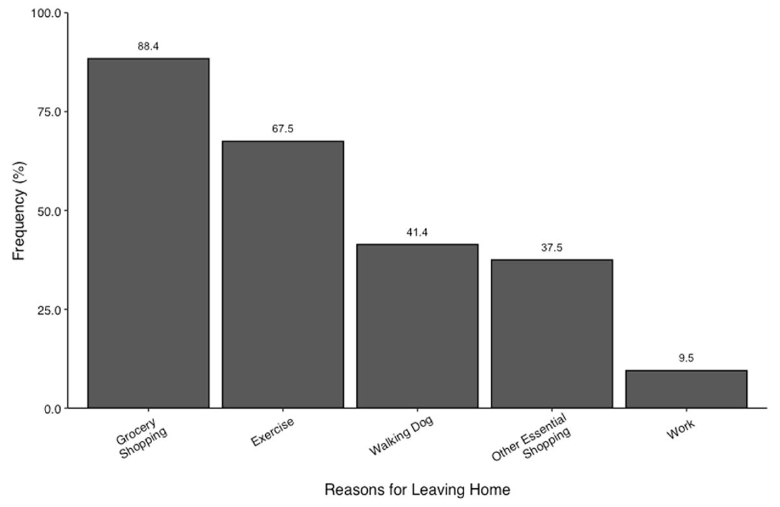

Slide 8
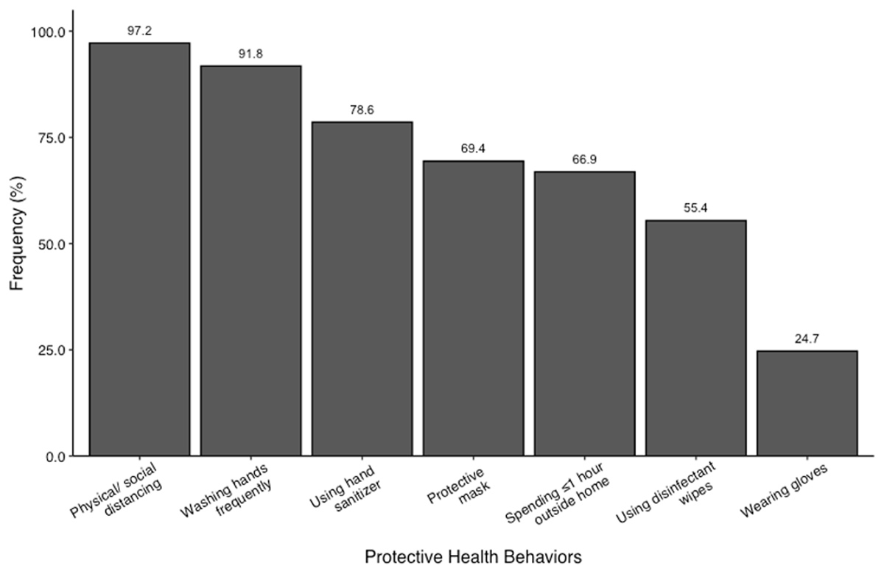

Slide 9
Key Findings for Leaving the Home
Rural residents had higher odds of leaving home for work compared with urban residents.
OR = 1.64.
Women reported significantly lower odds of leaving home for work, grocery and other essential shopping than men.
Participants reported an average of 2.4 +- 1.0 reasons for leaving the home.
Individuals that had one or more comorbidities had significantly lower odds of leaving the home. This is to be expected as individuals living with Asthma and other illnesses were in greater danger of serious long-term COVID 19 effects.
Oldest age bracket had higher odds for leaving home for grocery shopping (2.07) and the middle age bracket had higher odds for leaving home for work (1.90) compared to younger bracket.
Individuals without a college degree had significantly lower odds of leaving the home for grocery shopping (.53) and exercise(.69).

Slide 10
Key Findings for Protective Health Behaviors
Suburban residents had significantly greater odds (OR = 1.45) of spending at least 23 hours in the home compared to urban residents.
Rural residents had significantly lower odds of wearing a mask (.60) and gloves (.60) compared to urban.
Individuals reported engaging in 4.8 +- 1.3 behaviors in total.
It was found that individuals suffering from severe depressive symptoms had significantly lower odds of social distancing compared to people that presented with mild to none.
Women had sig higher odds of social distancing, washing hands frequently, wearing a mask, using sanitizer and using disinfectant. wipes.
Older individuals had higher odds of using protective masks yet significantly lower odds of spending at least 23 hours inside the home compared to the youngest age bracket.

Slide 11
“The major findings of this study were that in this sample of U.S. adults, those who were male, older, living without comorbidities, and residing in rural areas had higher odds of leaving the home. Additionally, those who were male, younger, and residing in rural areas had lower odds of enacting various protective health behaviours.”

Slide 12
Interactive Effects
Altered Multivariable logistic regression models

Slide 13
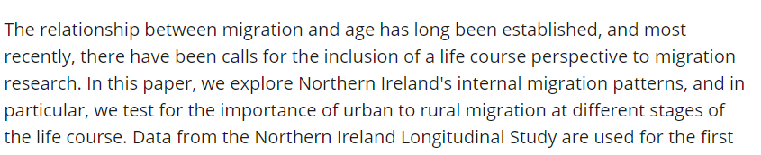
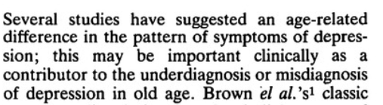
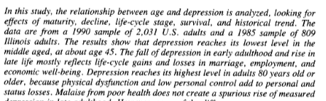
Age, Depression and Where We Live

Slide 14
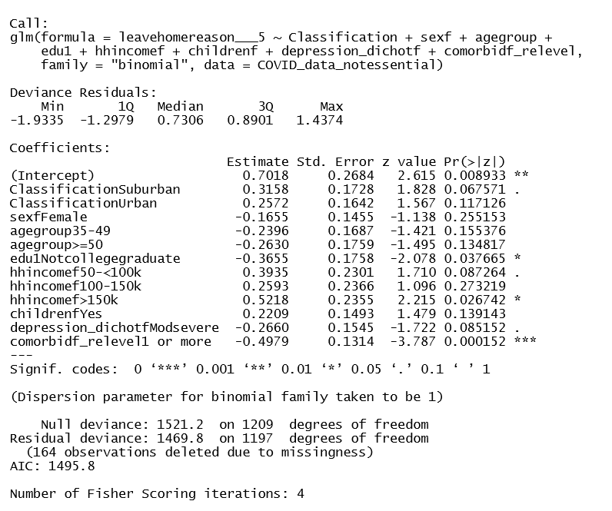
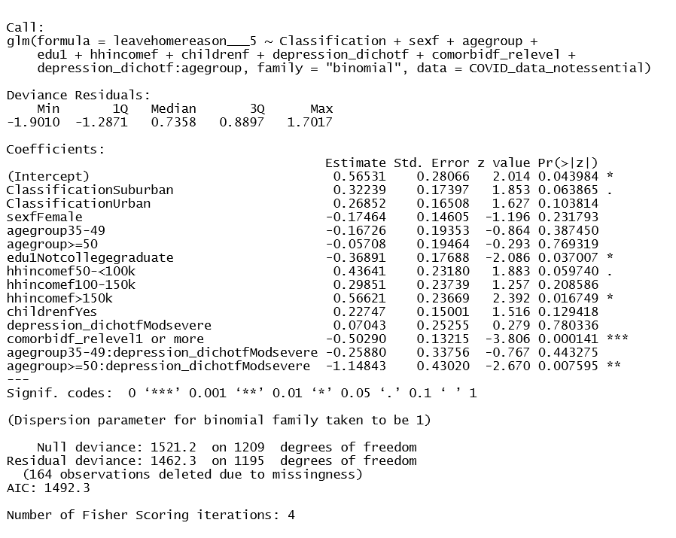
Without Interactive Effect
With Depression:Age Interaction

Slide 15
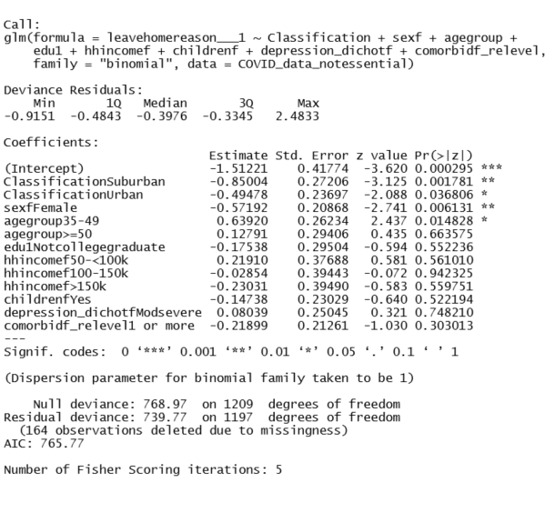
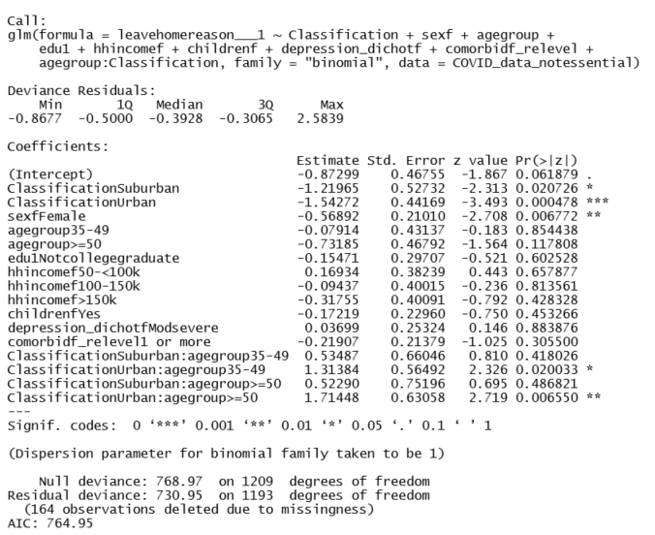
Without Interactive Effect
With Age:Classification Interaction (Area and Age)

Slide 16
Main Interaction Findings
Exercise
Walking the Dog
Work
The coefficient for the interactive term
for age and depression for the >= 50 group is negative
and statistically significant (-1.15, p = .008).
The effect of depression is significantly stronger
among this age group in decreasing the likelihood
of leaving home to exercise.
The coefficient for depression and age interaction is positive and a significant predictor in the 35-49 age group for LH to walk the dog (.67, p =.041).
The effect of depression is significantly stronger
among this age group in increasing the likelihood
of leaving home to exercise.
The coefficient for the interactive term
for age and area for the >= 50 group in Urban areas is positive
and statistically significant (1.71, p = .007).
It is also statistically significant for the 35-49 age group
living in urban areas (1.31, p = .02)
The effect of where you live is significantly stronger
among these age groups in increasing the likelihood
of leaving home to work.
.

Slide 17
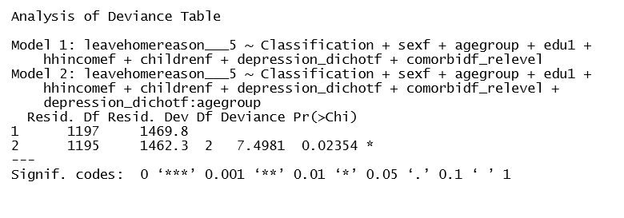
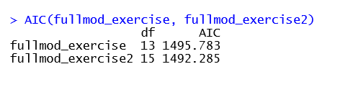
Model Testing
When introducing the interaction terms I tested the models using the Likelihood Ratio Test and the Akaike Information Criterion.
The model including the depression:agegroup interaction for LH to exercise was a better fit according to the LRT. This was reflected in a lower AIC score.
Including this interaction in the LH to walk the dog model produced a lower AIC score.
Including the age:classification interaction produced a lower AIC score than the original model for LH to work.

Slide 18
A Note on Model Fit
This study’s aim was to compare behaviour among different sections of society. The interactions here, even in models that did not present as a better fit under the LRT, are allowing us to gain clarity on how the effects vary among certain groups. The more in depth information attained through adding these variables is highly relevant for future health epidemic research and policy adherence planning.

Slide 19
References
Stockdale, A., & Catney, G. (2012). A Life Course Perspective on Urban-Rural Migration: the Importance of the Local Context. Population, Space and Place, 20(1), 83–98. https://doi.org/10.1002/psp.1758
Mirowsky, J., & Ross, C. E. (1992). Age and Depression. Journal of Health and Social Behavior, 33(3), 187. https://doi.org/10.2307/2137349
Katona, C. L., & Watkin, V. (1995). Depression in old age. Reviews in Clinical Gerontology, 5(4), 427–441. https://doi.org/10.1017/s095925980000486x

Slide 20
THANK YOU

